Slide 1

MedCommons RoadShow
Version 0.2
13 Jan 2004

Slide 2
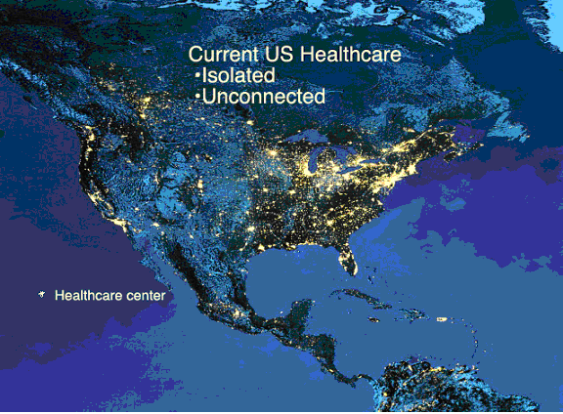
Islands of Healthcare

Slide 3
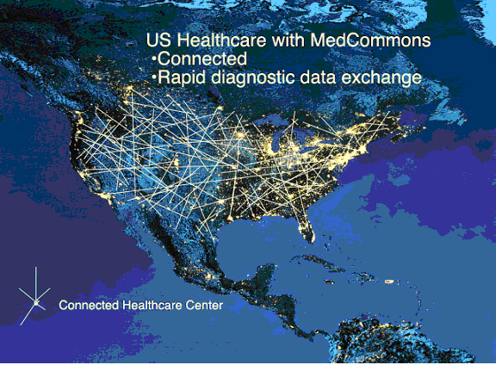
Networked Healthcare

Slide 4
MedCommons Network Applications
Patient portal
Drug trials
Patient follow-up
Image analysis
Second opinions
Night radiology

Slide 5
The Market
Diagnostic, Screening, and Treatment Planning Tests | Number of Tests (Annual, US) | Diagnostic Information Management Market | Projected Diagnostic Results Aggregation and Interchange Services Market
 |  |  | 2003 | 2005 | 2007
Radiology | 400,000,000 | $ 2 Billion | Negligible | $ 20 MM | $ 200 MM
Cardiology | 50,000,000 | $ 1 Billion | Negligible | $ 10 MM | $ 100 MM
Laboratory | 2,000,000,000 | $ 2 Billion | Negligible | $ 20 MM | $ 200 MM
 |  | $ 5 Billion | - | $ 50 MM | $500 MM

Slide 6
Themes
Quality
Patient Control
Integration

Slide 7
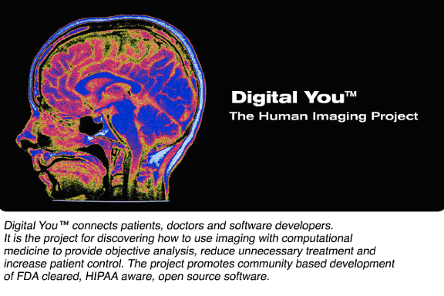

Slide 8
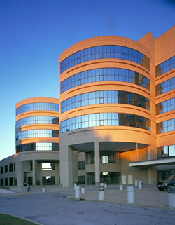

It's about PEOPLE, not institutions.
Privacy / Anonymity
Accessible, Independent Diagnostic Opinions
Lifetime Archive
HIPAA
INSTITUTIONS
Managed Care
Pharmaceuticals
Medical Devices
Patient Control
DMZ
PEOPLE
Patients
Physicians
Personal Devices

Slide 9
The Dream: People-Oriented
Diagnostic Technology
Private or Anonymous
Objective
Academic and Peer-Reviewed
Accessible
Lessens Anxiety
Without Mystery, Jargon or Secrecy

Slide 10
The Reality Integration and Penetration
Wanted: Critical Mass and “Network Effect”
Public Health and Public Policy
Security
Systems Biology
  Scans
  Proteomes
  Genomes
  Open Access Research
HHS: Placed Snomed and EHR in public domain

Slide 11
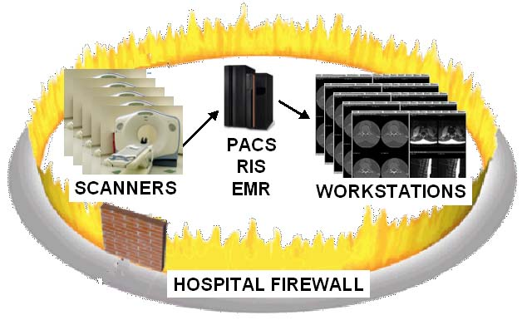
Before MedCommons

Slide 12
Roll-out Strategy
Medical Router appliance stands alone but is centrally managed
Pre-Network Value of MedCommons
  Referring Physician Access City-wide for PACS
  Migration Insurance for PACS
  Performance and Management Tools for PACS
Router Penetration will inspire Network Applications

Slide 13
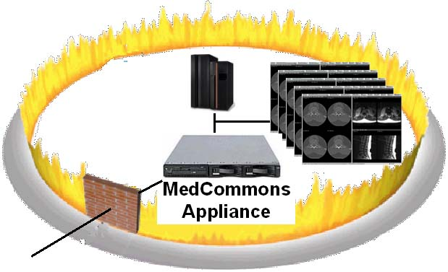
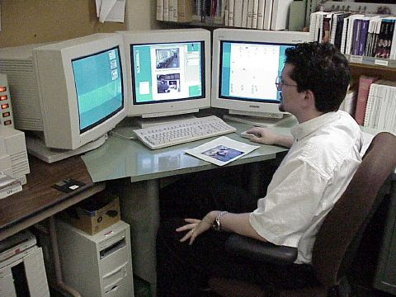
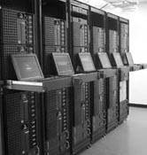
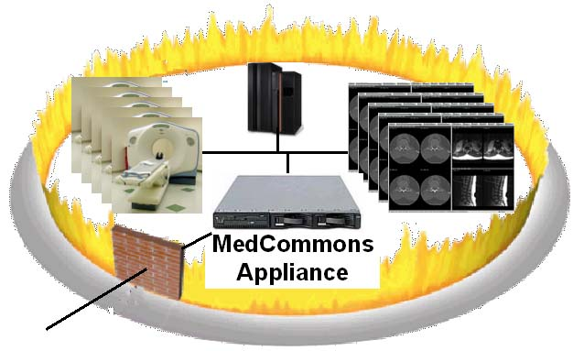
After MedCommons
Image Processing Lab
Physician’s Office
MedCommons
HIPAA and Customer Support
Service
Hospital

Slide 14
Driving Force: Quality
Unwarranted Variations in Healthcare
  Dartmouth Atlas
Quality
  Leapfrog Group
  Patient Safety Institute
  IHI
Reluctance
  Primary Care Docs
  Academic Medicine
  Pharmaceutical Co’s
Magnet for Excellence FDA Pitch

Slide 15
Objective Diagnostics as Leverage Over
Unwarranted Variations in Healthcare
Objective
Diagnostics
$
Treatment
$$$$$$$$$$$$$$$$$$$$
Physician
and
Patient

Slide 16
Open Source Diagnostic Software
Direct Benefits
  Peer Review
  Privacy / Anonymity
  Eliminate mystery, marketing hyperbole and secrecy
Indirect Effects
  Outcomes Research
  Reduce “supplier induced demand” for therapy

Slide 17
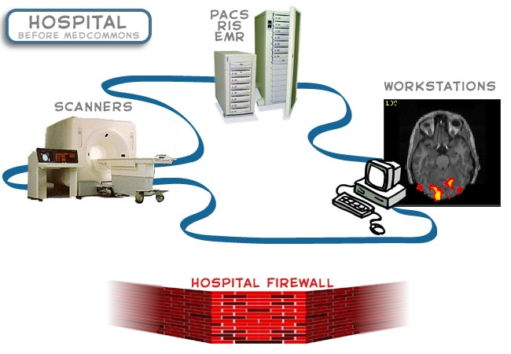
Interconnecting the Hospitals

Slide 18

MedCommons Medical Router
Enterprise Class Medical Router/Switch
Supports Industry Standard Protocols
  DICOMM
  HL7
  IHE
  Web Services
Remote Control and Monitoring from MedCommons NOC
Plug In Modules Support Different Product Sets

Slide 19
MedCommons Medical Router Applications
3D Accelerator Cache
21 CFR Part 11 Archival Storage
PACS/RIS/Protocol Test and Emulation
FDA/HIPAA Compliant Inter-Enterprise Transport
Open Source Viewer Support

Slide 20
Open Software Components
Linux, JBoss, Apache, MySql
Eclipse, Subversion, JUnit, DocBook
DCM4CHE, ITK/ ,….
PRIME, HL7 3.0 Schemas
MedCommons Contributions of Open Source ISO / FDA Tools

Slide 21
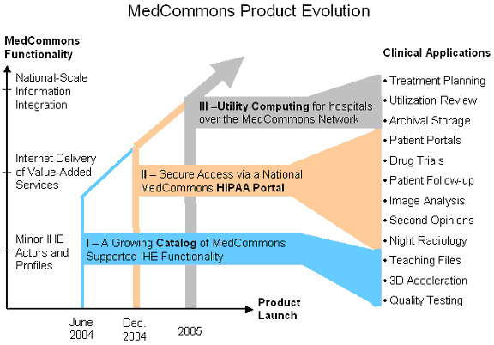

Slide 22
Milestones
March 2004
May 2004
May 2004
Dec 2004
Feb 2005
Mar 2005
FDA/ISO Environment
3D LAN Beta
SCAR Unveiling
Service and Router Beta
ISO Certification
Initial Product Ships

Slide 23


Phase I Unveiling

Slide 24
Integration of Business Strategy and Quality
Develop and defend the lead position as a nationwide diagnostic information services provider to hospitals, physicians, patients and their information systems vendors.
Develop and deploy a technology and processes that scale as demand grows to provide the highest quality-of-service, for the lowest cost, with the least capital investment.
Commercialize Open Source Software as a higher-quality, peer-reviewable and lower risk alternative to proprietary competitors while giving back to the Community our Quality Systems methods and associated code.
Provide high returns to our investors by erecting first-mover, market share, trademark, and intellectual property barriers to competition while staying true to Free / Open Source Software principles.

Slide 25
QMS Implementation Principals
Paperless workflow, docs and records
Open Source Quality Systems software components with modifications returned to the community
Proprietary processes and procedures
ISO 9001:2000 and FDA quality systems in place before any product and systems development begins

Slide 26
Document and Record Control
Eclipse IDE
Procedures and Forms Editor
Browser
Tortoise SVN Version Control Services
Internet
Apache Web Services
Process Forms Processor
Secure XML Utilities
Directory
Subversion
21 CFR - 11 Archive
Servers at Hosted Facility

Slide 27
MedCommons Directory
Users, Credentials and Passwords
Groups, Roles, Institutional Affiliations
Authorization Policies and Contexts
Contact Information
DICOM and HL7 Configuration

Slide 28
MedCommons Logs
Activity Logs
  Study Import
  Configuration Change
  Performance Alert
  Billing
HIPAA Access Logs
  Institutional Authorization
  Patient Authorization
  Recipient Authentication
  MedCommons Tracking Number

Slide 29
In Summary:
Managed Medical Router Appliance
Extend FDA/ISO Process to Open Source
MedCommons Diagnostic Information Services
Higher Order 3rd Party Services
Long-term Patient Control and Quality Mission

